Slide 1
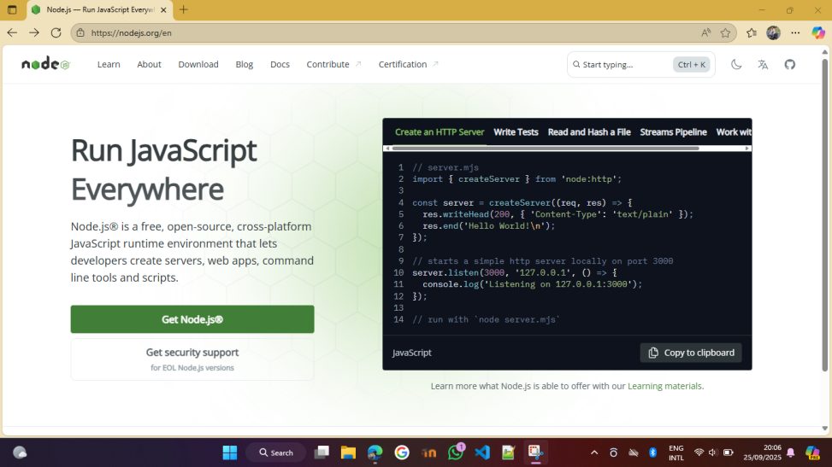
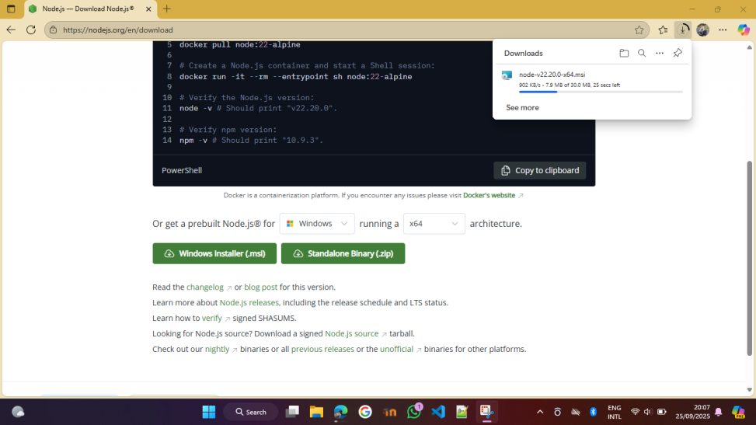
Install process of the node.js
1. Go to https://nodejs.org
2. Click windows Installer

Slide 2
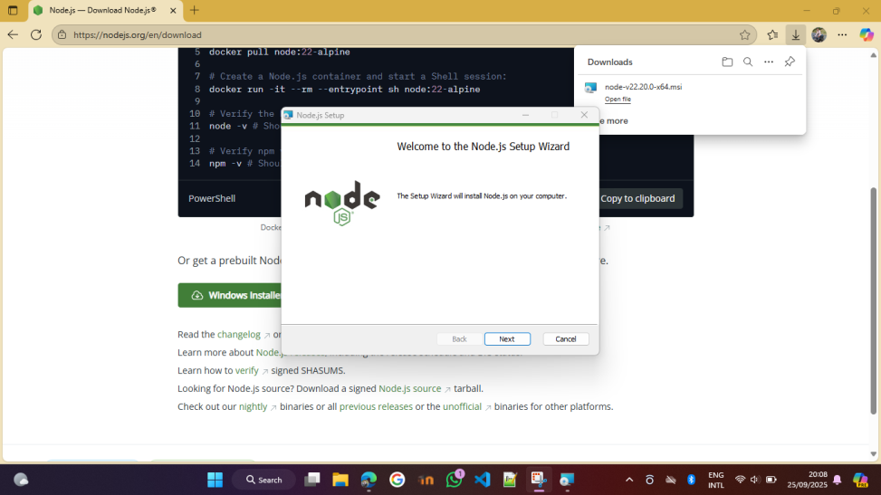
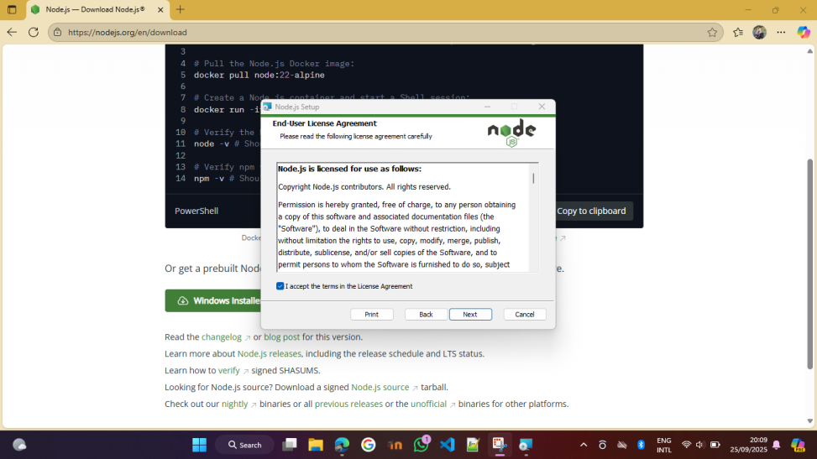
3. Follow the steps

Slide 3
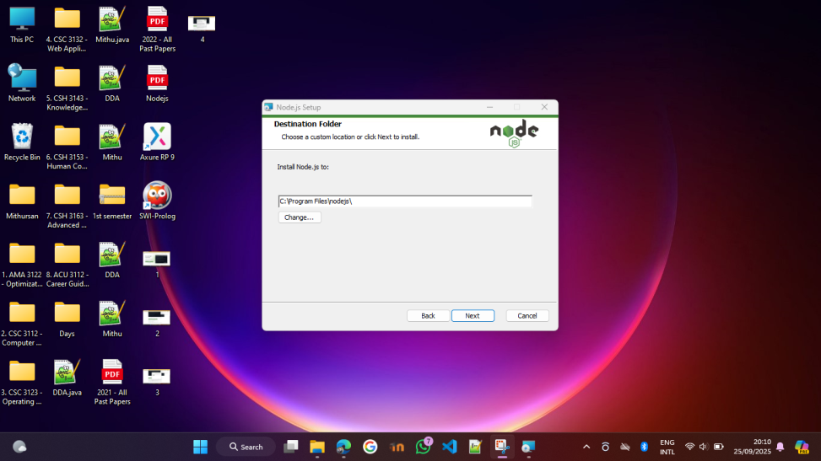
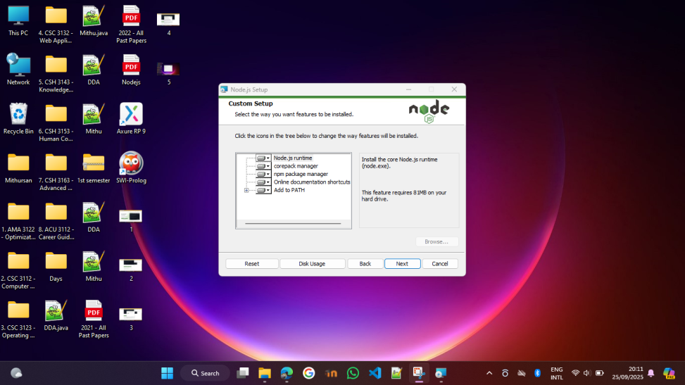
Other steps

Slide 4
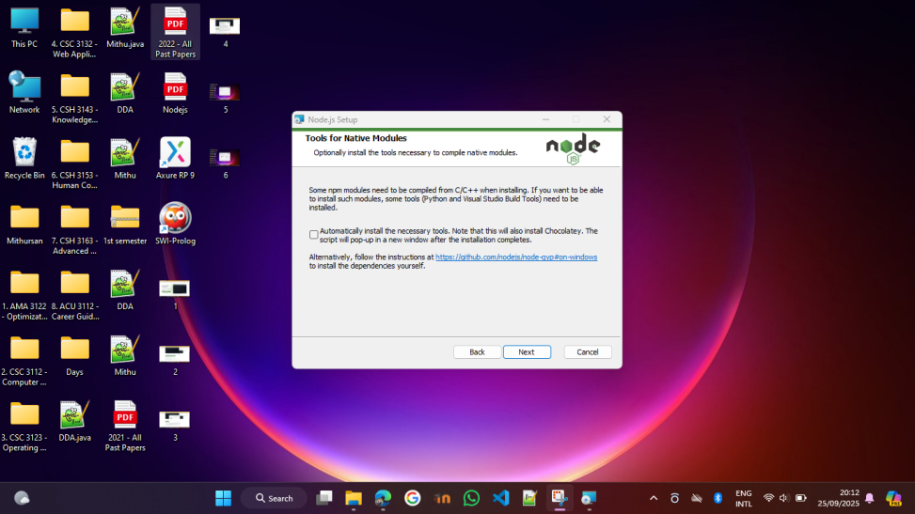

Other steps

Slide 5
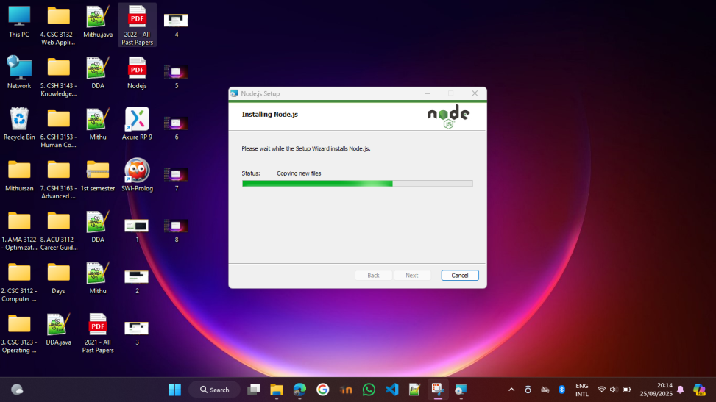

Other steps

Slide 6
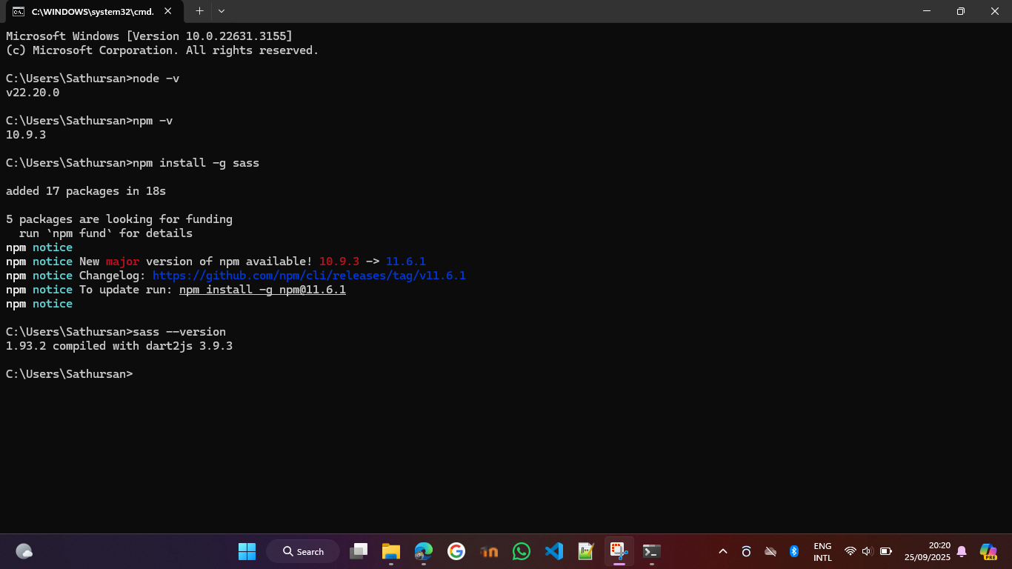
After Installation
Open Command prompt and type : node –v
Also check npm
(type: npm –v)
Install sass:
npm install –g sass
Here sass can be used anywhere on our system.
After it finishes, check if sass is installed:
sass –version
You should see a version number:
(e.g., 3.9.3)

Slide 7
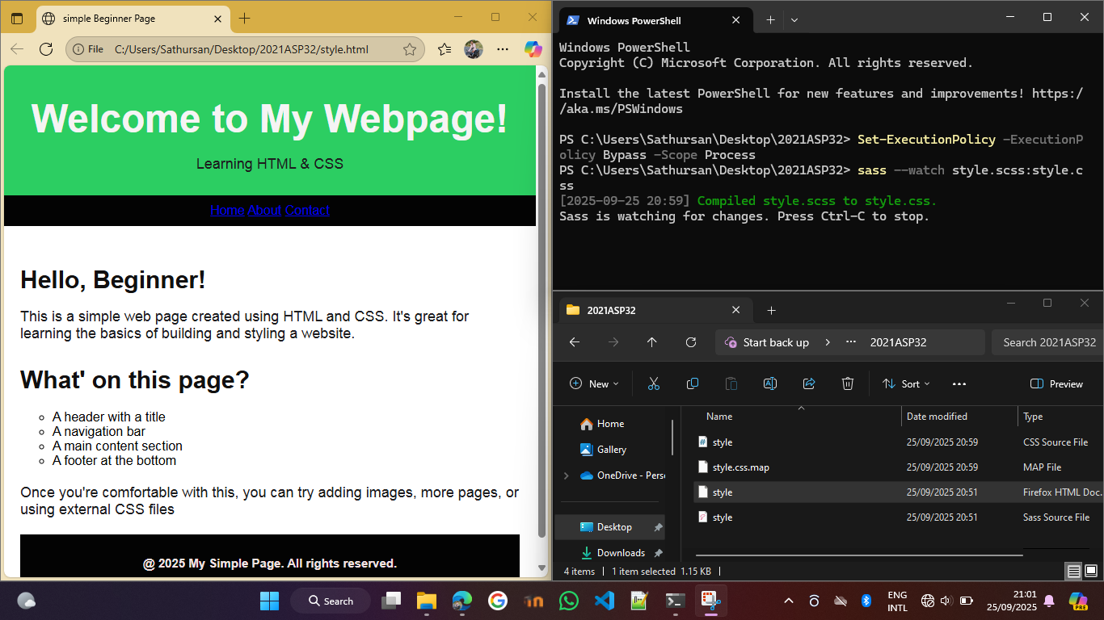
Compile a sass file
Now you can use sass in your project.
Example:
If you have a file called style.scss, compile it to CSS like this: sass style.scss style.css
It will create a new web.css file that browsers can read.
Auto-compile on save
While developing, you can make Sass watch for changes automatically:
sass --watch style.scss: style.css
Now every time you save style.scss, the CSS updates automatically.

